Slide 1


Slide 2

CHAPTER 5: Learning
College of Computing and Informatics
Department of Software Engineering
Fundamentals of Artificial Intelligence
Compiled by Aliazar D.
BSc & MSc in Software Engineering
aliazar.deneke@wku.edu.et

Slide 3
What is learning?
Learning is the process of acquiring new knowledge, skills, behaviors, or attitudes through experience, study, instruction, observation, practice, interaction with others, and etc.
It involves the ability to acquire, process, store, and use information and knowledge to make sense of the world around us and adapt to changing circumstances.
Learning can occur consciously or unconsciously, and it can be facilitated by a variety of factors, including motivation, attention, memory, feedback, and reinforcement.
It is a fundamental aspect of human development and is essential for personal growth, professional success, and social interaction.

Slide 4
Why we need learning?
Learning is essential for personal and professional growth, as well as for the development of society as a whole. Here are some reasons why we need learning:
Personal development: Learning helps individuals acquire new knowledge, skills, and attitudes that can enhance their personal and professional lives.
Socialization: Learning helps individuals develop social skills and interact effectively with others.
Innovation and progress: Learning is essential for innovation and progress in various fields such as science, technology, and the arts. It enables individuals to generate new ideas, solve complex problems, and create new products.
Adaptation to change: Learning helps individuals adapt to changing environments and circumstances. It enables them to acquire new skills and knowledge that can help them cope with new challenges and opportunities.
Personal fulfillment: Learning can provide individuals with a sense of personal fulfillment and satisfaction. It can help them pursue their interests and passions, and achieve their goals and aspirations.
Why computers or machines need learning?

Slide 5
Conti..
Learning is:
Memorizing something.
Knowing facts through observation and exploration.
Improving motor and/or cognitive skills through practice.
In the psychology literature, learning is considered one of the keys to human intelligence.
The idea behind learning is that percepts should not only be used for acting now, but also for improving the agent’s ability to act in the future.

Slide 6
Conti..
Some Examples of learning are :
Riding a bike (improve motor skills).
Memorizing Telephone number (memorizing).
Reading textbook (memorizing and operationalizing rules)
Playing chess and football (understanding the strategy and rule of the game).
Understanding Language (memorizing grammar and practicing).
Recognize face, signature and fraudulent credit card transactions (recalling patterns/features).
Notes:
Fraudulent credit card transactions refer to unauthorized or illegal activities that involve the use of stolen or fake credit card information to make purchases or obtain cash advances. These transactions can occur in various forms, such as online shopping, in-store purchases, or ATM withdrawals, and they can result in significant financial losses for both the cardholder and the card issuer. Fraudulent credit card transactions can be carried out by individuals or organized criminal groups, and they often involve sophisticated techniques such as skimming, phishing, or hacking. To prevent fraudulent credit card transactions, card issuers and merchants use various security measures such as encryption, fraud detection systems, and identity verification procedures. Cardholders can also protect themselves by monitoring their account activity regularly, reporting any suspicious transactions immediately, and keeping their card information secure.

Slide 7
Learning
Scholars Definition
“Learning denotes changes in a system that ... enable a system to do the same task more efficiently the next time.”
Herbert Simon
“Learning is constructing or modifying representations of what is being experienced.”
Ryszard Michalski
“Learning is making useful changes in our minds.”
Marvin Minsky

Slide 8
Learning Agent
A learning agent is an artificial intelligence (AI) system that can learn from its environment and improve its performance over time. It is designed to interact with its environment, observe the outcomes of its actions, and adjust its behavior accordingly.
A computer program is said to learn from experience E with respect to some class of tasks T and performance measure P.
The goal is to Improve on task, T, with respect to performance metric, P, based on experience, E.
T: Playing checkers.
P: Percentage of games won against an arbitrary opponent .
E: Playing practice games against itself.
T: Recognizing hand-written words.
P: Percentage of words correctly classified.
E: Database of human-labeled images of handwritten words.
T: Driving on four-lane highways using vision sensors.
P: Average distance traveled before a human-judged error.
E: A sequence of images and steering commands recorded while observing a human driver.
T: Categorize email messages as spam or legitimate.
P: Percentage of email messages correctly classified.
E: Database of emails, some with human-given labels.

Slide 9
Conti..
Factors for designing Learning Agent are:
Learning is essential for unknown environments, i.e. when designer lacks omniscience. It enables to organize new knowledge into general, effective representations.
Learning modifies the agent's decision mechanisms to improve performance.
Learning is useful as a system construction method, i.e. expose the agent to reality rather than trying to write it down.

Slide 10
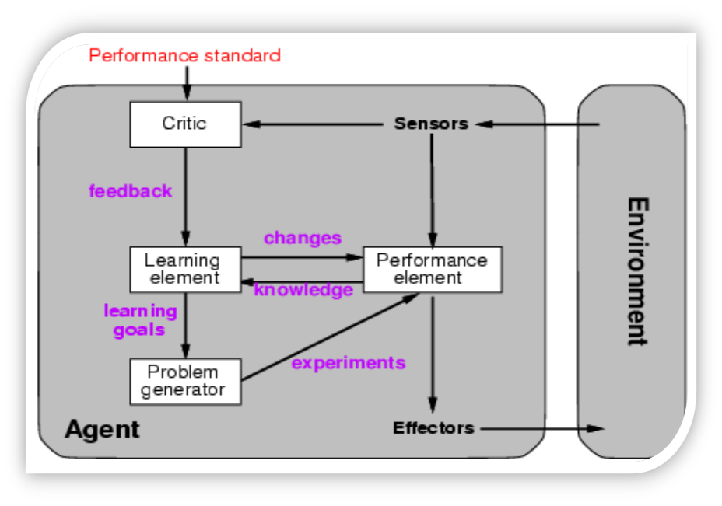
Conti..
What are four main components Learning agents?
Learning agents consist of four main components:
Learning element – the part of the agent responsible for improving its performance.
Performance element – the part that chooses the actions to take.
Critic – provides feedback for the learning element how the agent is doing with respect to a performance standard.
Problem generator – suggests actions that could lead to new, informative experiences (suboptimal from the point of view of the performance element, but designed to improve that element).

Slide 11
The Learning Problem
Given <x, f(x)> pairs, infer f
Given a finite sample, it is often
impossible to guess the true function f.
Approach: Find some pattern (called a hypothesis) in the training examples, and assume that the pattern will hold for future examples too.
x | f(x)
1 | 1
2 | 4
3 | 9
4 | 16
5 | ?

Slide 12


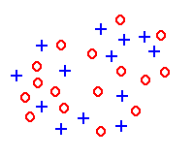
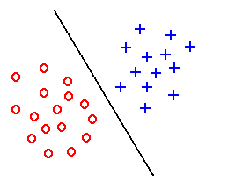
Feature extraction
Hair length y=0 cm
Hair length y=30cm
Male=
Female=
Task: to extract features which are good for classification.
Good features:
Objects from the same class have similar feature values.
Objects from different classes have different values.
“Good” features
“Bad” features

Slide 13
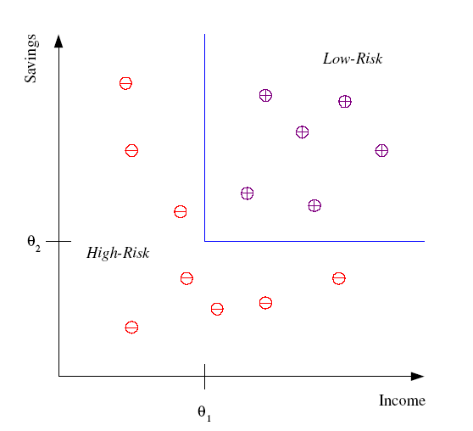
Classification
Example: Credit scoring
Differentiating between low-risk & high-risk customers from their income & savings.
Discriminant: IF income > θ₁ AND savings > θ₂ THEN
Low-risk
ELSE
High-risk
Applications of classification
Image classification
Sentiment analysis
Fraud detection
Spam filtering
Medical diagnosis
Notes:
Classification is a type of supervised learning in machine learning (ML) that involves categorizing data into predefined classes or categories. Here are some applications of classification in ML:
1. Image classification: Image classification is a common application of classification in ML. It involves categorizing images into different classes, such as animals, vehicles, or buildings. This can be used in various fields, such as medical imaging, security, and autonomous vehicles.
2. Sentiment analysis: Sentiment analysis is the process of categorizing text data into different sentiment categories, such as positive, negative, or neutral. This can be used in social media monitoring, customer feedback analysis, and market research.
3. Fraud detection: Classification can be used to detect fraudulent transactions in financial systems. By categorizing transactions into legitimate or fraudulent, the system can identify and prevent fraudulent activities.
4. Spam filtering: Classification can be used to filter out spam emails from legitimate ones. By categorizing emails into spam or not spam, the system can prevent unwanted emails from reaching the user's inbox.
5. Medical diagnosis: Classification can be used in medical diagnosis to categorize patients into different disease categories based on their symptoms and medical history. This can help doctors make accurate diagnoses and provide appropriate treatment.
In summary, classification is a powerful tool in ML that can be used in various applications, such as image classification, sentiment analysis, fraud detection, spam filtering, and medical diagnosis.

Slide 14








Face Recognition
Learning: it is training (adaptation) from data set.
Training examples of a person:
Face recognition is challenging because of the effect of facial expression, lighting, occlusion, make-up, hair style, etc.
Test images:

Slide 15
Types of Learning
Supervised learning: occurs where a set of input/output pairs are explicitly presented to the agent by a teacher.
The teacher provides a category label for each pattern in a training set, then the learning algorithm finds a rule that does a good job of predicting the output associated with a new input.
Unsupervised learning: Learning when there is no information about what the correct outputs are.
In unsupervised learning or clustering there is no explicit teacher, the system forms clusters or natural groupings of the input patterns.
Reinforcement learning: an agent interacting with the world makes observations, takes actions, & is rewarded or punished; it should learn to choose actions in order to obtain a lot of reward.
The agent is given an evaluation of its action, but not told the correct action. Reward strengthens likelihood of its action. Typically, the environment is assumed to be stochastic.

Slide 16
Conti..
Learning is a two step process.
Model construction: The training set is used to create the model. The model is represented as classification rules, decision trees, or mathematical formulae.
A training set is a set of problem instances (described as a set of properties and their values), together with a classification of the instance.
Model evaluation and usage: the test set is used to see how well it works for classifying future or unknown objects.
Test set is a set of instances and their classifications used to test the accuracy of a learned hypothesis.

Slide 17
Step 1: Model Construction
Classification
Algorithms
Training
Data
Classifier
(Model)
IF rank = ‘professor’
OR years > 6
THEN tenured = ‘yes’

Slide 18
Step 2: Using the Model in Prediction
Classifier
model
Testing
Data
Unseen Data
(Jeff, Professor, 4)
Tenured?

Slide 19
Learning Probabilistic Models
Probabilistic models are a powerful tool for artificial intelligence that can represent uncertainty and make predictions based on probabilities.
They can be used to model a wide range of phenomena, from weather patterns to financial markets to human behavior.
Learning probabilistic models involves the use of machine learning techniques to estimate the parameters of the model based on data.
The goal is to find the most likely values of the parameters given the observed data.

Slide 20
Conti..
There are two main types of probabilistic models: Generative models and Discriminative models.
Generative models learn the joint probability distribution of the input and output variables, and can be used to generate new data samples.
Discriminative models learn the conditional probability distribution of the output variable given the input variable, and can be used to make predictions or classifications.

Slide 21
Conti..
Overall, learning probabilistic models is an important part of machine learning and artificial intelligence, as it allows us to represent and reason about uncertainty in a principled and flexible way.
Some common machine learning techniques for learning probabilistic models include:
Maximum likelihood estimation,
Bayesian inference, and
Expectation-maximization.

Slide 22
Conti..
Maximum likelihood estimation (MLE) is a statistical method used to estimate the parameters of a probability distribution based on a set of observed data.
The goal of MLE is to find the values of the parameters that maximize the likelihood of the observed data.
Bayesian inference is a statistical method used to update the probability of a hypothesis based on new evidence or data.
It is based on Bayes' theorem, which states that the probability of a hypothesis given the data is proportional to the product of the prior probability of the hypothesis and the likelihood of the data given the hypothesis.
Expectation-maximization (EM) is a statistical algorithm used to estimate the parameters of a statistical model when some of the data is missing or incomplete.
It is an iterative algorithm that alternates between two steps: the expectation step (E-step) and the maximization step (M-step).

Slide 23
Conti..
Probabilistic models have many applications in AI, such as natural language processing, computer vision, robotics, and recommendation systems.
For example, in natural language processing, probabilistic models can be used to model the probability of different words and phrases, and to generate new sentences that are similar to those in the training data.
In computer vision, probabilistic models can be used to recognize objects in images and to estimate their poses and shapes.

Slide 24
Learning methods
There are various learning methods. Popular learning techniques include the following.
K-Nearest Neighbors:
Decision tree : divide decision space into piecewise constant regions.
Neural networks: partition by non-linear boundaries.
Bayesian network: a probabilistic model.
Regression: (linear or any other polynomial).
Support vector machine.
Expectation maximization algorithm.

Slide 25
Machine Learning

Slide 26
Machine Learning
Machine Learning (ML) is a subfield of artificial intelligence that focuses on the development of algorithms and models that can learn from data and make predictions or decisions based on that learning.
ML algorithms are used to analyze and interpret complex data, detect patterns, and make predictions or decisions.

Slide 27
Conti..
Machine learning (ML) enables machines to learn from data without being explicitly programmed.
Instead of relying on pre-defined rules or algorithms, Machine Learning systems learn by finding patterns and relationships in the data.
ML is used to solve a wide range of problems, such as image and speech recognition, natural language processing, fraud detection, and recommendation systems.
ML models can also be combined with other AI techniques, such as robotics, to create intelligent systems that can perceive and interact with the physical world.

Slide 28
Conti..
There are three main types of machine learning: Supervised learning, Unsupervised learning, and Reinforcement learning.
In supervised learning, the machine is trained on a labeled dataset, where each data point is associated with a corresponding label or output. The machine then learns to predict the output for new input data.
In unsupervised learning, the machine is trained on an unlabeled dataset, and the goal is to find patterns and relationships in the data.
In reinforcement learning, the machine learns through trial and error, by receiving feedback in the form of rewards or penalties for its actions.

Slide 29
Conti..
One of the key challenges in ML is the selection of appropriate algorithms, hyper parameters, and evaluation metrics for a given problem.
This requires expertise in statistics, computer science, and domain-specific knowledge.
In addition, ML algorithms require large amounts of data to train effectively, which can be a challenge in some domains.

Slide 30
Conti..
Some of the most popular machine learning algorithms used in AI include:
Linear regression,
Logistic regression,
Decision trees,
Support vector machines, and
Neural networks.

Slide 31
Conti..
Overall, Machine Learning is a powerful tool for solving complex problems and making predictions based on data. And It is a rapidly growing field that has revolutionized many industries and aspects of our daily lives.
As the demand for intelligent systems that can learn from data continues to grow, the field of machine learning is expected to play an increasingly important role in the development of artificial intelligence.
And also as AI continues to advance, we can expect to see even more sophisticated and intelligent ML algorithms and models that can learn from diverse sources of data and make more accurate predictions and decisions.

Slide 32
Neural Networks

Slide 33
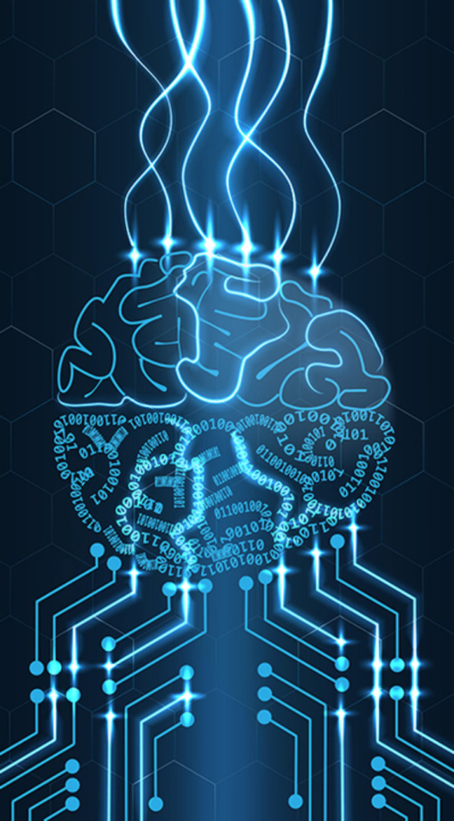
Neural Networks
Neural networks are a key component of artificial intelligence, and they are used to model and solve a wide range of problems in different domains such as computer vision, natural language processing, speech recognition, image recognition and more.

Slide 34
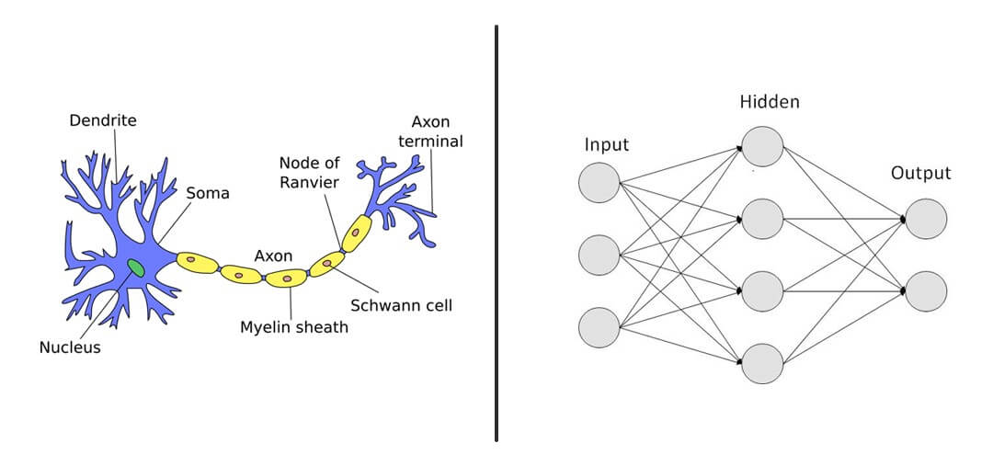
Conti..
A neural network is a computational model that is inspired by the structure and function of the human brain.
It consists of layers of interconnected processing units called neurons that work together to process and learn from input data.
Each neuron receives input from other neurons or from the external world, processes it, and then passes the output to other neurons in the network.
The connections between neurons are represented by weights that are learned during the training process.

Slide 35
Conti..
During training, the neural network is fed a large amount of labeled data, which it uses to adjust the weights of its connections in order to improve its accuracy in making predictions.
Once the neural network has been trained, it can be used to make predictions on new, unseen data.
There are many different types of neural networks, each with its own strengths and weaknesses.

Slide 36
Conti..
Some common types of neural networks include:
Feedforward neural networks,
Convolutional neural networks, and
Recurrent neural networks.
Each of these types of networks is designed to excel at a specific type of task, such as:
Image classification,
Object detection, or
Sequence modeling.

Slide 37
Conti..
One of the key advantages of neural networks is their ability to learn complex, non-linear relationships between input and output data, making them well-suited for tasks that involve pattern recognition, classification, and prediction.
However, training a neural network requires a large amount of data, computational resources, and careful selection of network architecture and hyperparameters.
Overall, neural networks are a powerful tool for solving a wide range of problems in artificial intelligence, and they continue to be an active area of research and development.

Slide 38
Natural Language Processing

Slide 39
Natural Language Processing
Natural language processing (NLP) is a field of computer science, artificial intelligence (also called machine learning), and linguistics concerned with the interactions between computers and human through (natural) languages.
The process of a computer extracting meaningful information from natural language input and/or producing natural language output.
Natural language understanding is sometimes referred to as an AI-complete problem because it seems to require extensive knowledge about the outside world and the ability to manipulate it.

Slide 40
NLP:HLT
Human Language Technologies are information technologies that are specialized for dealing with the most complex information medium in our world: human language.
Covers a broad range of activities with the eventual goal of enabling people to communicate with machines using natural communication skills.
Consists of: Computational Linguistics (CL) and Speech Technology as its core.

Slide 41
Conti..
Computational Linguistics (CL) is an interdisciplinary field dealing with the statistical and/or rule-based modeling of natural language from a computational perspective.
Speech Technology relates to the technologies designed to duplicate and respond to the human voice.
To aid the voice-disabled, the hearing-disabled, the blind, and to communicate with computers without a keyboard, to market goods or services by telephone and to enhance game software.
Consists of speech recognition, speech synthesis, speaker recognition, speaker verification.

Slide 42
Conti..
NLP is used to solve a wide range of problems, such as text classification, sentiment analysis, language translation, question answering, and text summarization.
One of the key challenges in NLP is the ambiguity and variability of human language.
Words can have multiple meanings, and their meaning can depend on the context in which they are used.
In addition, human language can be imprecise, idiosyncratic (unique to an individual), and subject to cultural and regional variations.

Slide 43
Conti…
To address these challenges, NLP researchers use a variety of techniques, such as statistical models, rule-based systems, and machine learning algorithms.
Some of the most popular machine learning algorithms used in NLP include:
Neural networks,
Decision trees, and
Support vector machines.
NLP also involves the use of linguistic resources, such as lexicons, grammars, and ontologies, to help computers understand the structure and meaning of human language.
These resources are often created manually by linguists or through crowdsourcing platforms.
Lexicons is the complete set of meaningful units in a language.
An ontology is a formal description of knowledge as a set of concepts within a domain and the relationships that hold between them.

Slide 44
Levels of Language Processing
Phonetics and Phonology: The study of linguistic sounds.
Morphology: The study of the meaningful components of words.
Syntax: The study of the structural relationships between words.
Semantics: The study of meaning.
Pragmatics: The study of how language is used to accomplish goals.
Discourse: The study of linguistic units larger than a single utterance.

Slide 45
Major Tasks in NLP
Speech recognition
Text-to-speech
Speech segmentation
Optical character recognition
Morphological segmentation
Stemming
Part-of-speech tagging
Word segmentation
Word sense disambiguation
Named entity recognition
Sentence breaking
Parsing
Question answering
Information extraction (IE)
Information retrieval (IR)
Query expansion
Natural language search
Automatic summarization
Natural language generation
Text simplification
Text-proofing
Topic segmentation and recognition
Coreference resolution
Relationship extraction
Sentiment analysis
Automated essay scoring
Natural language understanding
Discourse analysis
Machine translation

Slide 46
Conti..
Overall, NLP is a rapidly growing field with numerous applications in various domains, such as healthcare, finance, education, and entertainment.
As the demand for intelligent systems that can process and understand human language continues to grow, the field of NLP is expected to play an increasingly important role in the development of artificial intelligence.

Slide 47
Robotics

Slide 48
Robotics
Robotics is a branch of engineering and computer science that deals with the design, construction, operation, and application of robots.
Robots are machines that are programmed to perform a wide range of tasks, ranging from simple repetitive actions to complex cognitive processes.
Artificial Intelligence (AI) plays a critical role in robotics, as it enables robots to perceive, reason, and act in the physical world.
AI techniques such as machine learning, computer vision, natural language processing, and decision making, are used to develop intelligent robotic systems.

Slide 49
Conti..
Some of the key applications of robotics in AI include:
Manufacturing,
Logistics,
Healthcare,
Agriculture, and
Exploration.

Slide 50
Conti..
In manufacturing, robots are used to automate repetitive and dangerous tasks, increase production efficiency, and reduce costs.
In logistics, robots are used for order picking, packing, and transportation, enabling faster and more accurate delivery of goods.

Slide 51
Conti..
In healthcare, robots are used to assist with surgery, rehabilitation, and patient care, providing support to healthcare professionals and improving patient outcomes.
In agriculture, robots are used for crop monitoring, harvesting, and spraying, improving yields and reducing the use of pesticides.
In exploration, robots are used to perform tasks in space, deep sea, and hazardous environments, enabling humans to explore and understand these environments without risking their lives.

Slide 52
Conti..
One of the key challenges in robotics is ensuring the safety and reliability of robotic systems, particularly when they interact with humans.
This requires the development of robust and accurate sensing, control, and communication systems that can handle unpredictable situations and adapt to changing environments.
Overall, robotics is an exciting and rapidly growing field that has the potential to transform many industries and aspects of our daily lives.
As AI continues to advance, we can expect to see even more sophisticated and intelligent robotic systems in the future.

Slide 53
Perception

Slide 54
Perception
Perception is a subfield of artificial intelligence that deals with the ability of machines to sense, interpret, and understand the world around them.
Perception involves the use of sensors and algorithms to gather and process data from the environment, and to extract meaningful information from that data.

Slide 55
Conti..
Perception is an important part of many AI systems, particularly those that interact with the physical world.
Examples of perception-based AI applications include:
Autonomous vehicles,
Robotics, and
Smart home devices.

Slide 56
Conti..
Perception involves several key components, including sensing, processing, and interpretation.
Sensing involves the use of sensors such as cameras, microphones, and other devices to capture data from the environment.
Processing involves the use of algorithms to analyze and filter the data, and to extract relevant features such as shapes, colors, and textures.
Interpretation involves the use of machine learning algorithms to understand and interpret the data, and to make decisions or take actions based on that understanding.

Slide 57
Conti..
One of the key challenges in perception-based AI is dealing with the complexity and variability of real-world environments.
The same object can appear differently depending on lighting conditions, camera angle, and other factors.
In addition, real-world environments can be unpredictable and chaotic, with unexpected obstacles and events.
To address these challenges, perception-based AI systems use a variety of techniques, such as deep learning, computer vision, and signal processing.
These techniques allow AI systems to learn from data and to adapt to changing environments.

Slide 58
Conti..
Overall, perception is a critical component of many AI systems, as it enables machines to sense and interact with the world around them.
As AI continues to advance, we can expect to see even more sophisticated and intelligent perception-based AI systems that can operate in a wide range of environments and applications.

Slide 59


Slide 60


